Slide 1
Project Progress
DATA 400
From Listing to Booking: Predictive Insights into Airbnb Performance
(Exploring the key factors behind successful Airbnb listings)
By: Hannie Pham & Pham Duy Anh Vu

Slide 2

Table of Contents
1. Introduction
2. Tractable Data and Data Retrieval
3. EDA
4. Ethical, Legal & Societal Implications
6. What next? and Expected Results?
5. Stakeholder Implications

Slide 3


Introduction
🏠 Background
Airbnb has transformed the hospitality industry by allowing individuals to list their homes and unique spaces for travelers.
With millions of listings worldwide, competition among hosts is intense.
❓The Problem
Not all listings perform equally - some attract more guests, earn better reviews, or command higher prices.
What makes certain listings stand out?
🎯 Project Objectives
To analyze Airbnb listings data and build a prediction model that helps identify key factors contributing to a “good” listing.
Data Collection, EDA, and machine learning to uncover patterns and provide actionable insights.
Collection→ Analyze → Predict

Slide 4
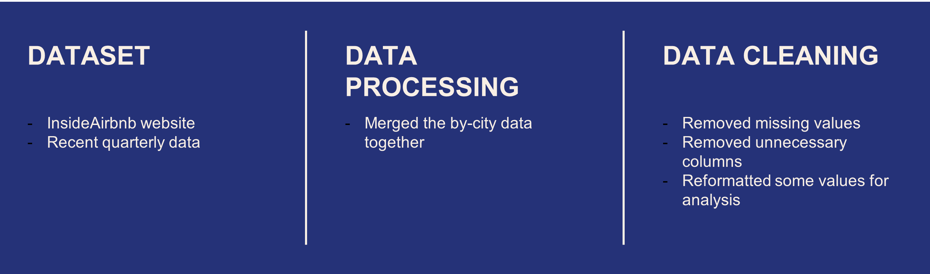
Data Retrieval

Slide 5
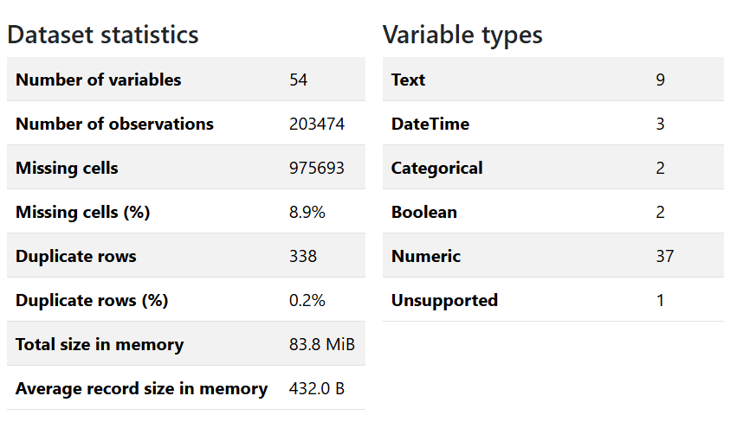

Slide 6
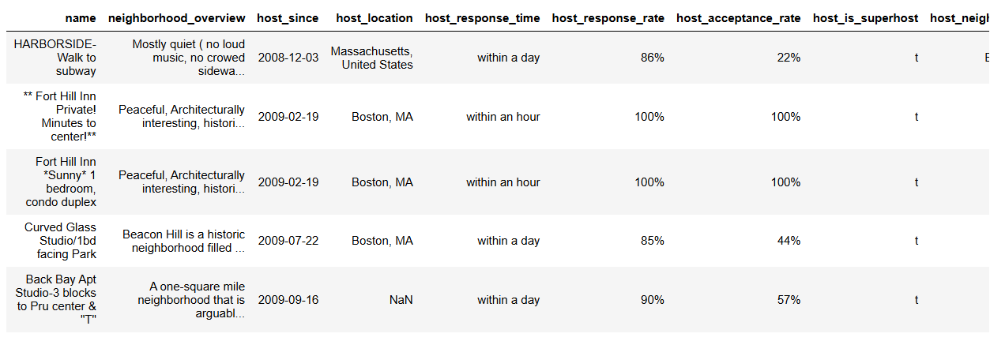
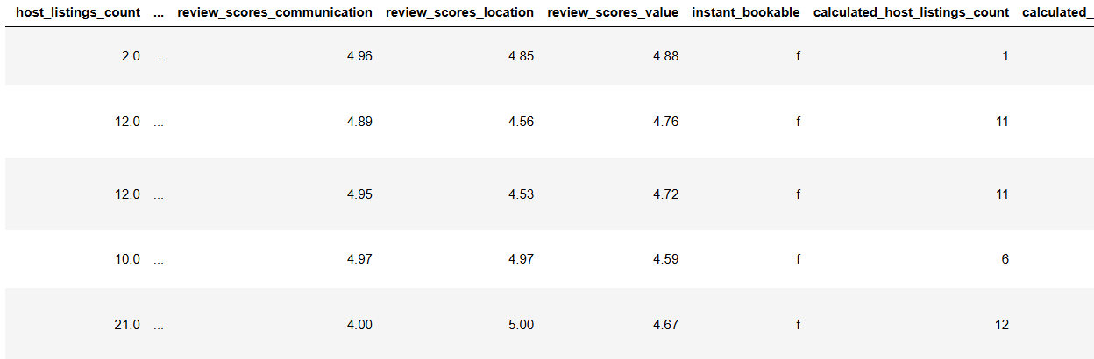

Slide 7
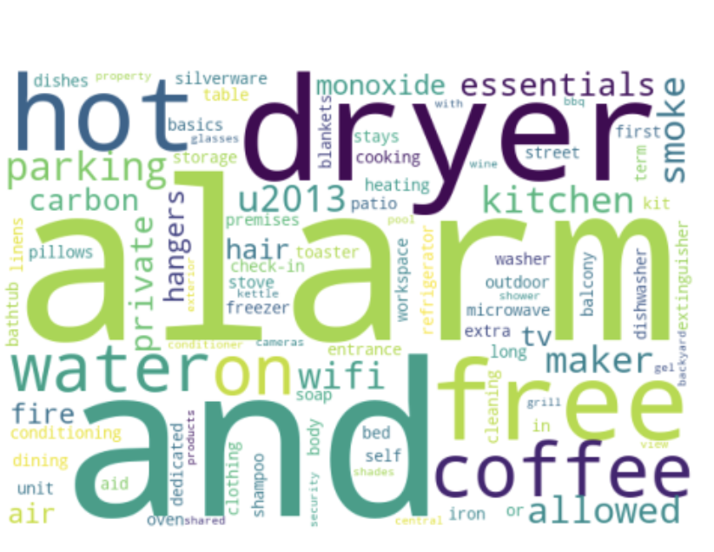

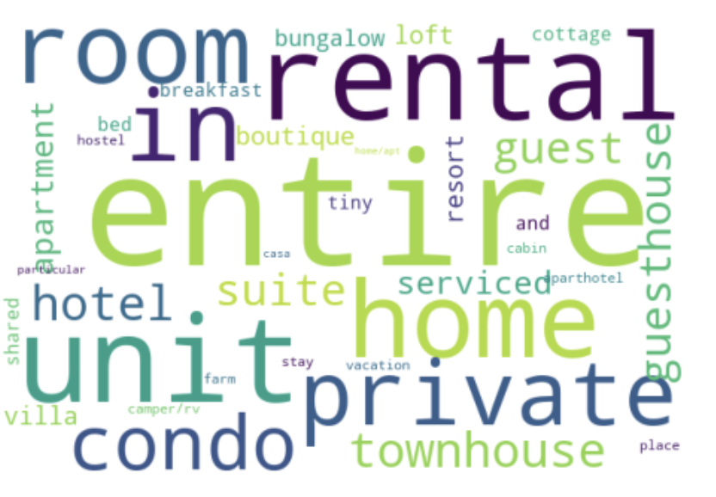

EDA
Amenities
Price (per night)
Property Types
Host Location

Slide 8
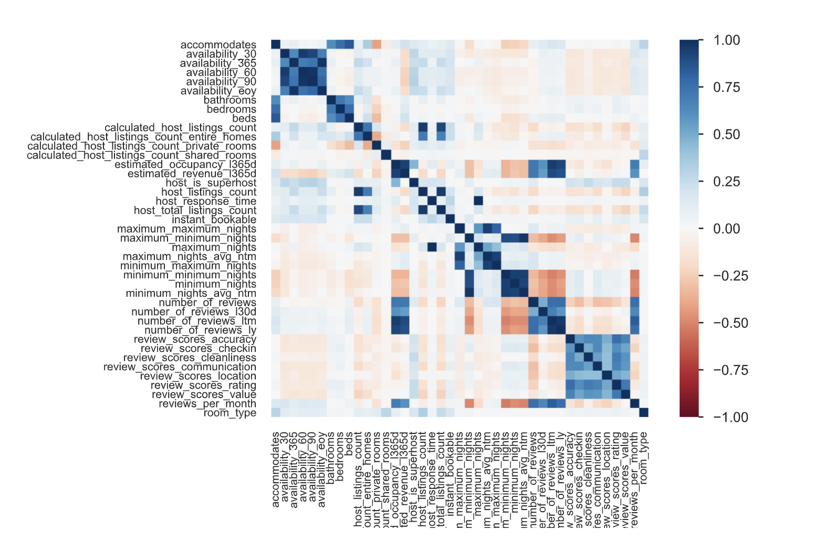
✅ Review Scores Are Highly Correlated
Features like review_scores_rating, review_scores_accuracy, review_scores_cleanliness, etc., are strongly positively correlated.
Insight: Guests tend to rate all review categories consistently (e.g., a good experience reflects across all areas).
🏠 Property Size Features Correlate
bedrooms, beds, and bathrooms show strong positive correlation.
Insight: Larger listings naturally have more beds and amenities.
📉 Some Negative Correlations
minimum_nights and availability features have mild negative correlation with review/occupancy metrics.
Insight: Listings with high minimum stays or full-year availability may not perform as well.

Slide 9
🔐 Ethical
Ensure privacy: No personal or sensitive data collected
Be aware of algorithmic bias in reviews or location-based features
📜 Legal
No resale, redistribution, or use of data beyond academic scope
Airbnb does not allow unauthorized web scraping. The platform explicitly states in its terms of service that any automated collection of data is prohibited without their consent.
🌍 Societal
Accessibility: Encourage inclusive, equitable insights — not just profit-maximizing advice.
ETHICAL, LEGAL, SOCIETAL IMPLICATIONS

Slide 10



IMPLICATIONS FOR STAKEHOLDERS​
HOSTS
GUESTS
AIRBNB
Help improve listing
Know where/what to invest
Get the most out of listings
Know which listing to promote
Improve user engagement

Slide 11
What next?
🚀 Next Steps
Train & evaluate models (Linear Regression, Random Forest, etc.) to predict 'good' listings
Analyze feature importance & interpret stakeholder implications
Finalize EDA visualizations, code, and report
Prepare for Readme, Poster
🔮 Results Expectations
Key Outcomes: Predict high ratings, reviews, or occupancy
Top Predictors:
Host Quality: Superhost status, response time
Listing Content: Title/description length, amenities
Pricing: Competitive relative to nearby listings
Location: Near landmarks or transit
Model Estimates:
R² = 0.60–0.80 (regression), 70–85% accuracy (classification)
Value: Data-driven tips for hosts to improve listing performance

Slide 12

Thank you for Listening!

